Slide 1
Positive and Negative
Testing

Slide 2
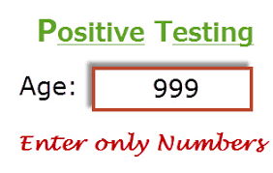
Positive Testing
Positive testing, also known as "happy path testing," focuses on validating that a software application functions as expected when provided with valid and correct input.
It aims to ensure that the system behaves correctly under normal or expected conditions.
The goal is to confirm that the software meets its functional requirements and produces the intended results.
Example of Positive Testing:
Suppose you are testing a simple calculator application. Here are some positive test cases:
Addition: Entering the numbers 5 and 3 as operands and clicking the "+" button should display the result "8."
Subtraction: Entering 10 and 4 as operands and clicking the "-" button should display the result "6."
Multiplication: Entering 6 and 7 as operands and clicking the "×" button should display the result "42."
Division: Entering 20 and 5 as operands and clicking the "÷" button should display the result "4."

Slide 3
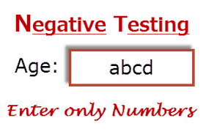
Negative Testing
Negative testing, focuses on testing the software's ability to handle invalid, unexpected, or erroneous input gracefully.
It is designed to uncover how the system responds to abnormal conditions and ensures that it does not crash, produce incorrect results.
Example of Negative Testing:
Suppose you are testing a simple calculator application. Here are some negative test cases:
Division by Zero: Attempting to divide any number by zero should result in an error message or handle the situation gracefully, rather than crashing or displaying an incorrect result.
Non-Numeric Input: Entering non-numeric characters (e.g., letters or symbols) as operands should result in an error message, as the calculator expects numeric input.
Overflow: Entering very large numbers as operands in multiplication should ensure that the calculator handles numeric overflow correctly, rather than returning an erroneous result or crashing.
Invalid Operators: Entering an invalid operator (e.g., "@" instead of "+") should result in an error message or handle the situation appropriately.

Slide 4
Assignment
Prepare Positive and Negative Scenarios for https://www.saucedemo.com/
https://demoqa.com

